Slide 1
Hear Disease Prediction
Capstone Project
Aashish Bansal
19BIT0346
B.Tech. IT

Slide 2
Abstract

Slide 3
Abstract
Develop an optimized learning model
Develop a user interface to display predictions for users.
Take input from user and predict based on it
Efficient training of the model

Slide 4
Introduction

Slide 5
Introduction
Number of deaths are rising for the heart disease patients
Several causes due to change in lifestyle and habits
Accurate patient diagnosis and treatment are required
Users should be warned beforehand, if required
Amount of medical information required is enormous

Slide 6
Problem Statement

Slide 7
Problem Statement
Provide insights based on inputs
Attempt to predict as accurately as possible
Optimize the model
Connect the learning model to the software for use

Slide 8
High-Level Architecture

Slide 9
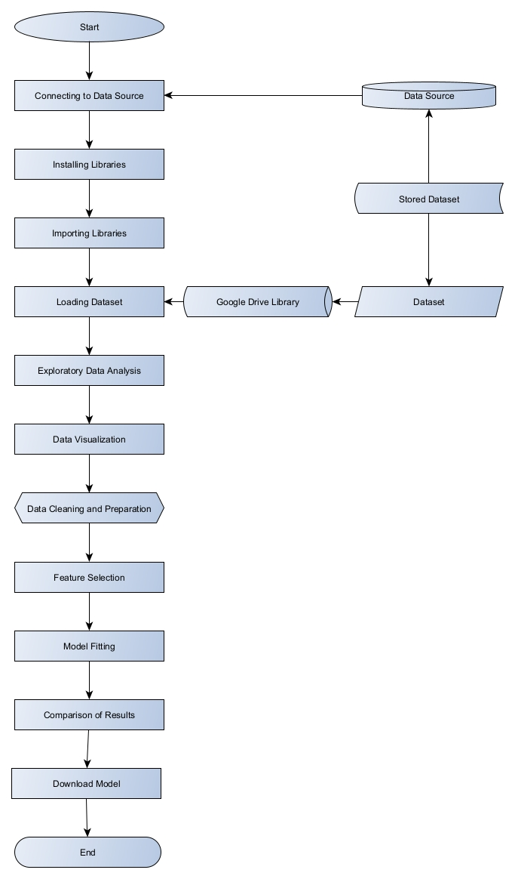
High-Level Architecture Diagram
Connecting to Database
Installing Libraries
Importing Libraries
Loading dataset
Exploratory data analysis
Data visualization
Data cleaning and preparation
Feature selection
Model fitting
Comparison of results
Downloading Model

Slide 10
Low Level Architecture

Slide 11
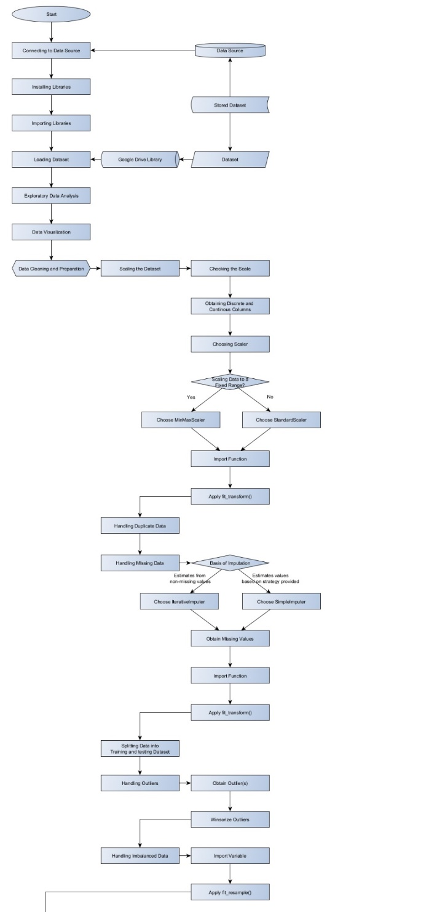
Low Level Architecture Diagram
Connecting to Database
Installing Libraries
Importing Libraries
Loading dataset
Exploratory data analysis
Data visualization
Data cleaning and preparation
Scaling the dataset
Handling duplicate data
Handling missing data
Splitting data into training and testing data
Handling outliers
Handling imbalanced data

Slide 12

Low Level Architecture Diagram
Feature selection
Obtaining correlation
Obtaining best features
Model fitting (Hyperparameter Optimization)
Logistic Regression
Decision Tree Classifier
Random Forest
SVC
Comparison of results
Downloading Model

Slide 13
Data Flow Diagram

Slide 14
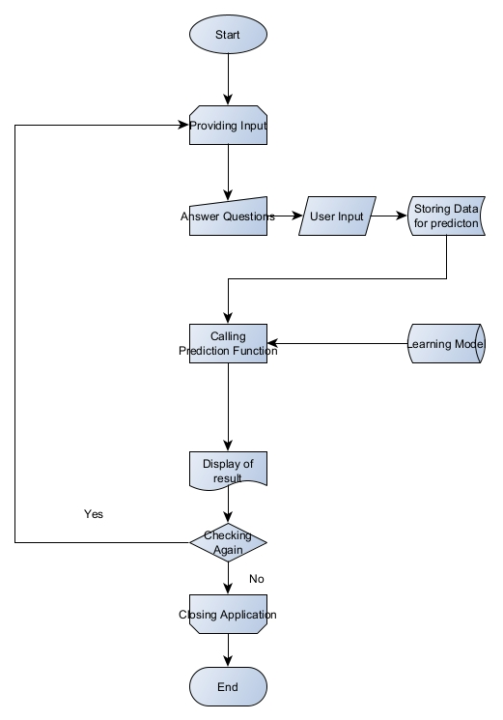
Data Flow Diagram
Providing Input
Answering Questions
User Input
Storing data for prediction
Calling prediction function
Display of Result

Slide 15
Challenges

Slide 16
Challenges
Because of the illness's intricacy and the numerous elements that can contribute to it, accurately predicting heart disease is challenging.
It might be challenging to collect reliable and thorough data regarding a patient's medical history and lifestyle habits.
It might be difficult to detect tiny changes in a patient's health that may suggest an increased risk of heart disease.
Creating successful predictive models necessitates a huge quantity of data and processing power, both of which may be costly and time-consuming to obtain.

Slide 17
Limitations
The accuracy of the data used to develop predictive models is restricted, therefore any faults or inaccuracies in the data can lead to erroneous forecasts.
Predictive models are also limited in their ability to forecast future outcomes based on past data; therefore, they may not always be able to predict future occurrences or patterns in a patient's health or lifestyle habits.
Predictive models are also limited in their ability to detect small changes in a patient's health that may suggest an increased risk of heart disease, because these changes are not always evident or easily detectable with present technology or procedures.

Slide 18
Research Challenges
Larger dataset needs to created because it is required for deep learning algorithms to work properly
Not much valuable information on deep learning algorithms used in this because of the small datasets being used.
Mostly machine learning algorithms are being used.
Few optimizations
Not much quality research
Requirement of a new and detailed dataset

Slide 19
Dataset
Source: Kaggle
Framingham Heart Disease Dataset

Slide 20
Dataset
No. of Records: 4240
No. of Features: 16
No. of Attributes: 15
Classification Goal: predict whether the patient has a 10-year risk of future coronary heart disease
dataset provides the patients’ information

Slide 21
Attributes
Demographic:
Sex: male or female(Nominal)
Age: Age of the patient;(Continuous - Although the recorded ages have been truncated to whole numbers, the concept of age is continuous)
Behavioral
Education: 0: Less than High School and High School degrees, 1: College Degree and Higher
Current Smoker: whether or not the patient is a current smoker (Nominal)
Cigs Per Day: the number of cigarettes that the person smoked on average in one day. (can be considered continuous as one can have any number of cigarettes, even half a cigarette.)
Medical( history)
BP Meds: whether or not the patient was on blood pressure medication (Nominal)
Prevalent Stroke: whether or not the patient had previously had a stroke (Nominal)
Prevalent Hyp: whether or not the patient was hypertensive (Nominal)
Diabetes: whether or not the patient had diabetes (Nominal)
Medical(current)
Tot Chol: total cholesterol level (Continuous)
Sys BP: systolic blood pressure (Continuous)
Dia BP: diastolic blood pressure (Continuous)
BMI: Body Mass Index (Continuous)
Heart Rate: heart rate (Continuous - In medical research, variables such as heart rate though in fact discrete, yet are considered continuous because of large number of possible values.)
Glucose: glucose level (Continuous)
Predict variable (desired target)
10 year risk of coronary heart disease CHD (binary: “1”, means “Yes”, “0” means “No”)

Slide 22
Requirements

Slide 23
Hardware Requirements
Local Machine
Google Collaboratory
Processor: Intel i7 10th Generation @2.70 GHz
RAM: 32GB
GPU: NIVIDIA GeForce GTX 1650Ti (4 GB)
GPU Type: Dedicated
Processor: Intel Xeon CPU @2.20 GHz
RAM: 13 GB
GPU: Tesla K80 accelerator (12 GB GDDR5 VRAM)

Slide 24
Software Requirements
Anaconda Studio
Jupyter Notebook
Spyder
Visual Studio Code
Python
Google Drive

Slide 25
Literature Survey

Slide 26
Literature Survey
S. No. | Title of the Paper | Year | Dataset Name | Algorithms | Methods | Metrics
1 | Heart Disease Prediction using Hybrid ML Algorithms | 2023 | Framingham Heart Study (FHS) dataset |  | Particle Swarm Optimization | Naïve Bayes (Accuracy: 87.6%; Precision: 84.32%), Hybrid Algorithms (Accuracy: 97.43%; Precision: 94.65%)
2 | Improving Accuracy of Heart Disease Prediction through Machine Learning Algorithms | 2023 | UCI Heart Disease dataset; Framingham Heart Study Dataset; Heart Disease Cleveland Uci Dataset; Cardiovascular Disease Dataset | Logistic Regression, Random Forest, Decision Tree, k-Nearest neighbour(knn) | Attribute selection is performed through decision tree learning approach and random forest learning approach. | Logistic Regressson (89.59%), KNN (80.97%), Random Forest(83%), Decision Tree (82.63%)
3 | Coronary Heart Disease Prediction and Classification using Hybrid Machine Learning Algorithms | 2023 | Framingham Heart Laboratory | Decision Tree (DT) and Ada Boosting |  | Naïve Bayes (Accuracy: 87.6%; Precision: 84.32%), Hybrid Algorithms (Accuracy: 97.43%; Precision: 94.65%)
4 | Machine Learning based Mobile App for Heart Disease Prediction | 2023 | Not mentioned | Random Forest, Logistic Regression, and ANN Multilayer Perceptron | method bagging | Not provided
5 | Heart Disease Prediction using Ensemble ML | 2023 | UCI Heart Disease dataset | SVM Classifier, KNN, Decision Tree, AdaBoost Classifier, Gaussian NB, Gradient Boosting Algorithm, MLP Classifier, Random Forest Classifier | Normal ML Model | KNN: 91.76%, DT: 95.13%, SVC: 95.88, RF: 95.50%, AdaBoost: 94.38, MLP: 95.88%, Gaussian Naïve Bayes: 94.38%, DVC: 98.12%, Gaussian Naïve Bias: 95.88%

Slide 27
Literature Survey
S. No. | Title of the Paper | Year | Dataset Name | Algorithms | Methods | Metrics
6 | An Effective Heart Disease Prediction Method using Extreme Gradient Boosting Algorithm Compared with Convolutional Neural Networks | 2023 |  | KNN, Naive Bayes, SVM, Simple Logistic Regression and ANN | CAD procedures | ANN: ~85%, CNN: ~95%, KNN: ~55%, Naïve Bayes: ~75%, SVM: ~80%, XGBoost: ~90%
7 | A Review: Heart Disease Prediction in Machine Learning & Deep Learning | 2023
8 | Machine Learning based Cardiac Disease Prediction- A Comparative Analysis | 2023 | UCI | Naïve Bayes, Logistic Regression, Random Forest | ETL, Data Enrichment | Navie Bayes: 84.12%, Random Forest: 87%, Logistic Regression: 80%
9 | Heart Disease Prediction: Optimization of Machine Learning Algorithms | 2023 |  | KNN, DT, RF, LR, SVM | Smoothing, normalization, and grouping | LR: 87.01%, SVM: 86.04%, KNN: 74.68%, DT: 96.97, RF: 96.75%
10 | A Comparison of Supervised Learning Algorithms to Prediction Heart Disease | 2023 | UCI | KNN, SVC, MLP |  | KNN: 91.8%, SVC: 90.16%, MLP: 88.52%

Slide 28
Literature Survey
S. No. | Title of the Paper | Year | Dataset Name | Algorithms | Methods | Metrics
11 | A Methodology For Early Prediction and Classification of Heart Diseases in Diabetic Patients With Machine Learning Techniques | 2022 | UCI | RF Classifier, LR Classifier, SVM |  | Avg Accuracy: 93.26%
12 | Machine Learning Based Classification Algorithms Performance Analysis for Heart Disease Prediction | 2022 | UCI Cleveland heart disease dataset | LR, NB, KNN, DT, Ensemble Learning, RF, Gradient Boosting, XGBoost | ROC, AUC | LR: 82%, NB: 75%, KNN: 88%, DT: 75%, RF: 82%, AdaBoost: 84%, Gradient Boosting: 81%, XGBoost: 79%
13 | Heart Disease Prediction using Clustered Genetic Optimization Algorithm | 2023 | UCI | K-Means | Clustered Genetic Algorithm, Segmentation Process, Optimization Process | Accuracy: 94.56%
14 | Software Development Framework for Cardiac Disease Prediction Using Machine Learning Applications | 2022 | UCI Cleveland | RF, Ensemble Learning with RF and Bagging | Bootstrap methods | KNN: 90.25%, DT: 79.21%, LR: 85.25%, SVM: 81.97%, RF: 91.1%
15 | Machine Learning and Deep Neural Network Techniques for Heart Disease Prediction | 2022 | UCI repository | KNN, NB, SVM, AdaBoost, RF, DT, LR, XGBoost, LGBM, GB, CatBoost |  | XGB: 81.1%, Deep Neural Network: 85.9%

Slide 29
Data Visualizations

Slide 30
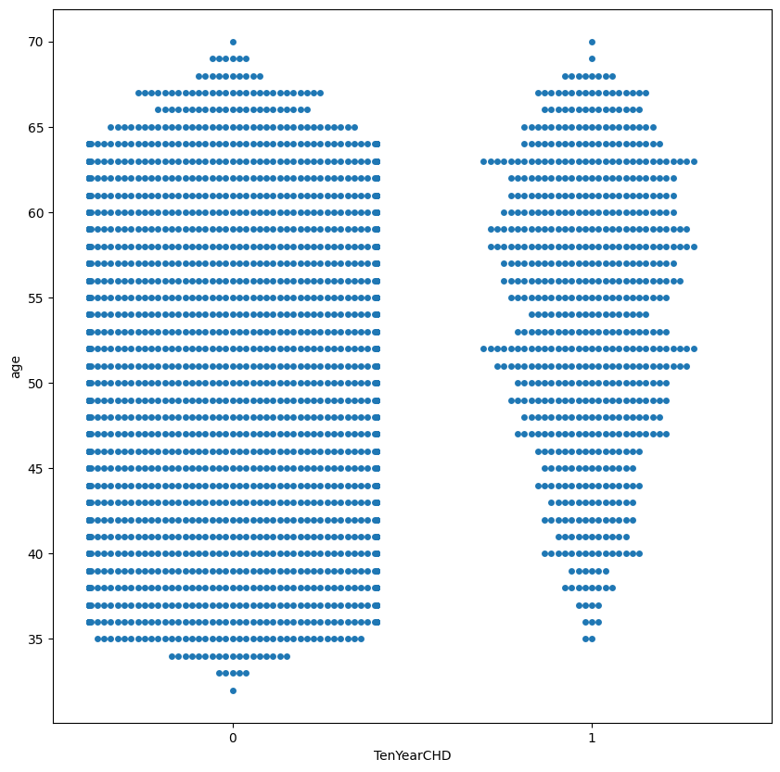
Age Vs Heart Disease
The people who suffer from the diseases are either around 50 years or 65 years.

Slide 31
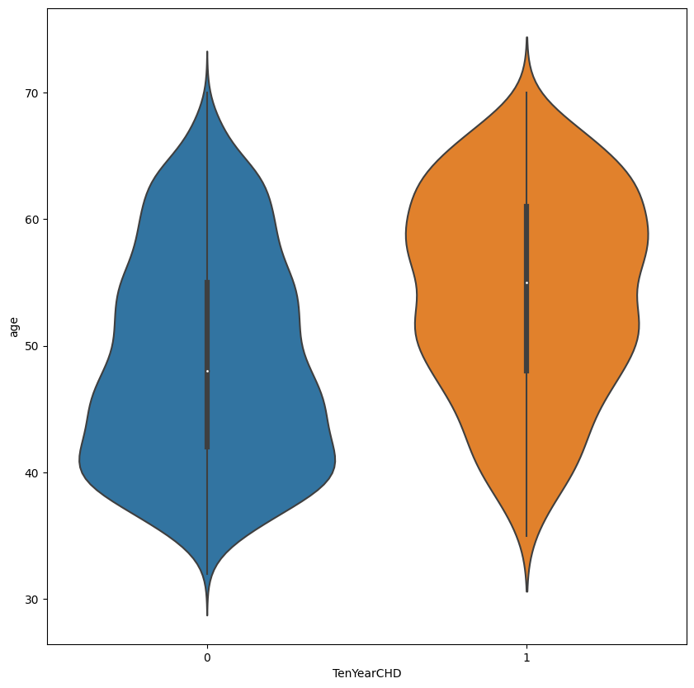
Age Vs Heart Disease
Violin plot tells that most patients of age around 40-55 have 0 risk
Most patients of age around 60-65 have risk of disease (CHD)

Slide 32
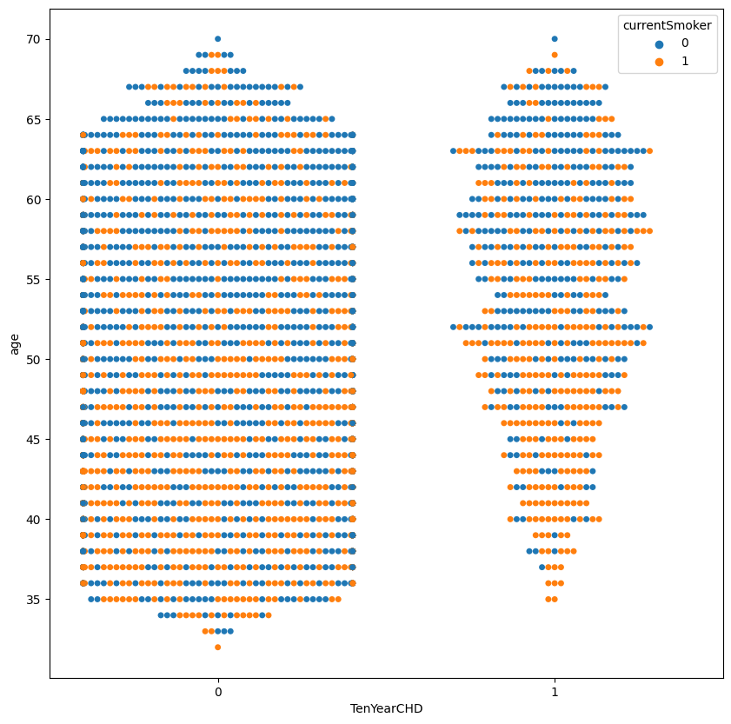
Age vs Heart Disease for Smokers and Non-Smokers
In contrast to the earlier distribution, smokers having no risk of CHD are in age around 40 years
non-smokers having risk are in age around 65-70 years Also most smokers having risk are in age around 50 years

Slide 33
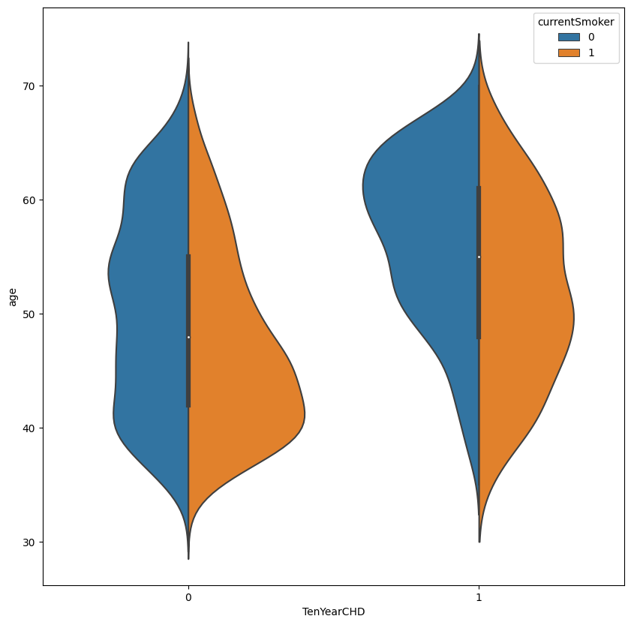
Age vs Heart Disease for Smokers and Non-Smokers
From this violin plot, we see that most of smokers having no risk of CHD are in age around 40 years
But most of non-smokers having risk are in age around 65-70 years Also most smokers having risk are in age around 50 years

Slide 34
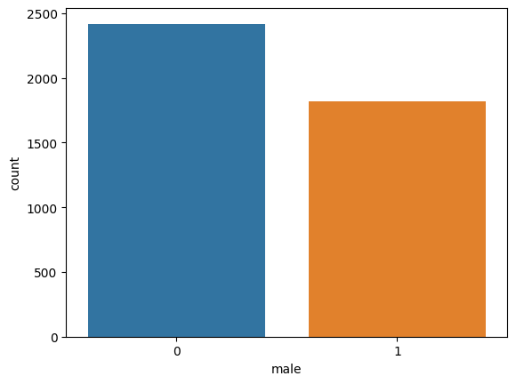
Gender Count
Diseases are more common in females as compared to males.

Slide 35
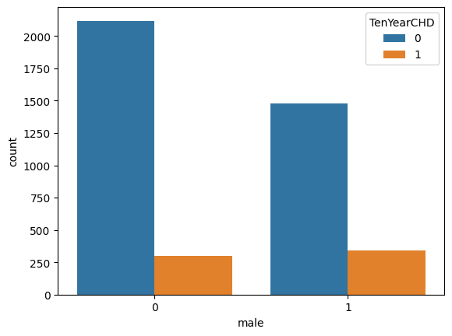
Gender vs Heart Disease
According to this plot, there are more female in the data as compared to males.
There are more females having no risk than males having no risk
There are slightly more males having risk than females having risk

Slide 36
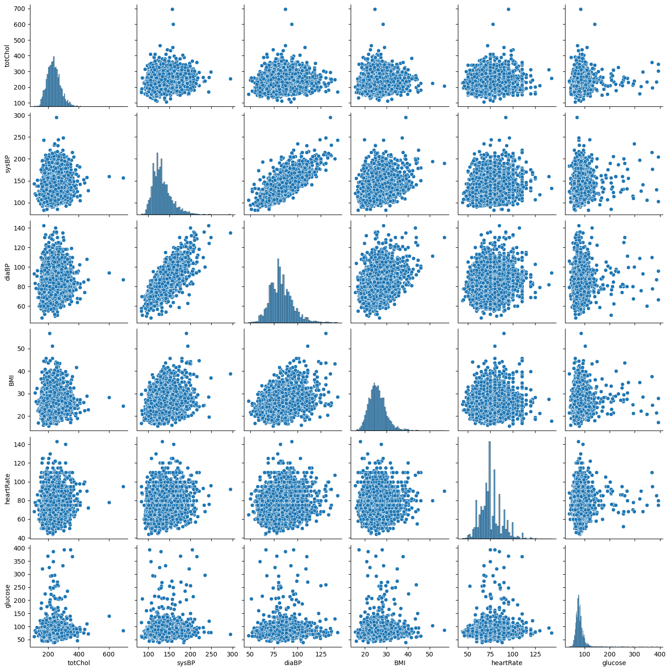
Understanding Correlation
sysBP and diaBP are highly correlated
currentSmoker and cigsPerDay are highly correlated

Slide 37
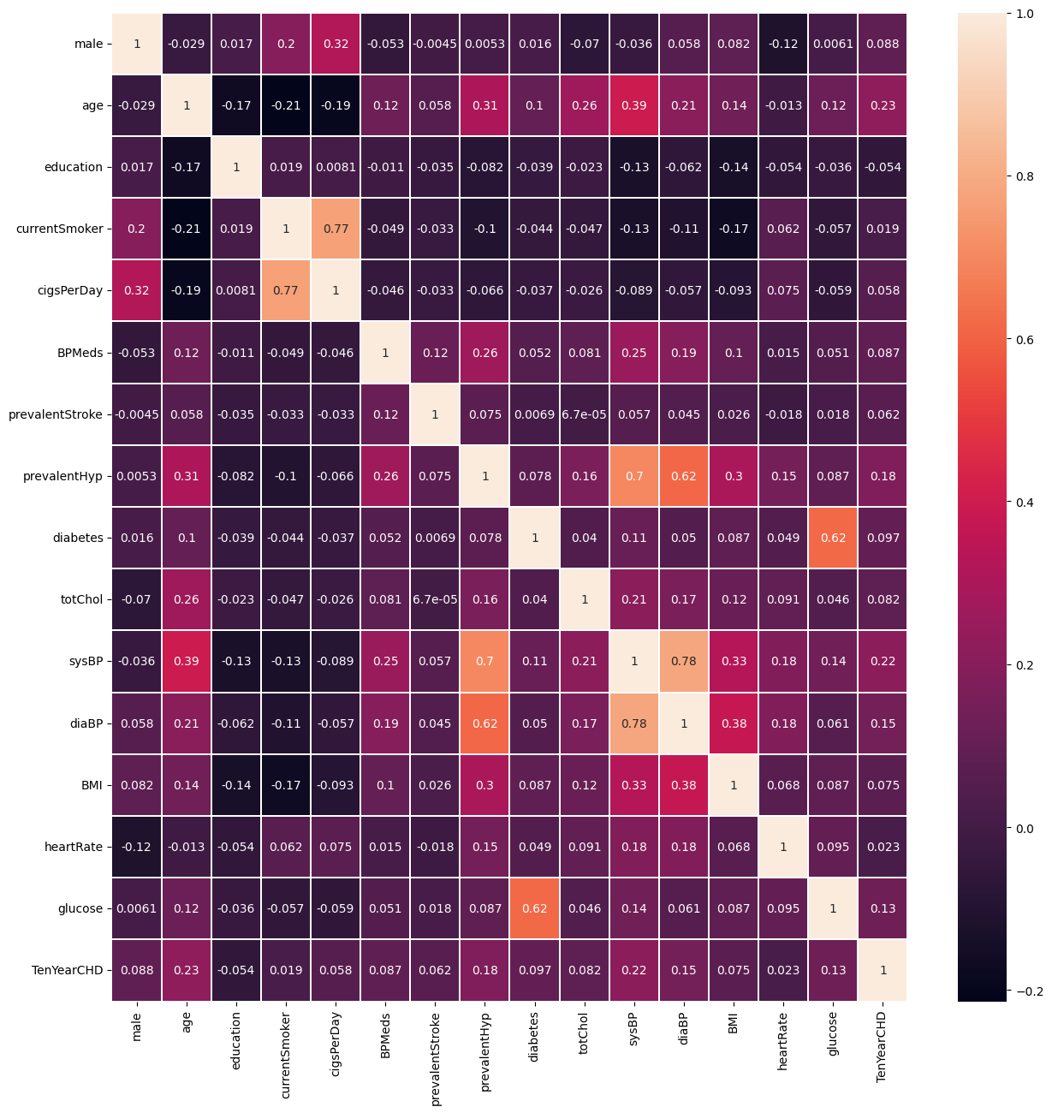
Understanding Correlation
sysBP and diaBP are highly correlated
currentSmoker and cigsPerDay are highly correlated

Slide 38
Learning Algorithms Used

Slide 39
Learning Algorithms Used
Logistic Regression
Decision Tree Classifier
Random Forest Classifier
SVC

Slide 40
Results Obtained

Slide 41
Metrics
 | Untuned |  |  |  |  |  |  |  | Tuned
 | Accuracy |  | Precision |  | Recall |  | F1-Score |  | Accuracy |  | Precision |  | Recall |  | F1-Score
Algorithm | Train | Test | Train | Test | Train | Test | Train | Test | Train | Test | Train | Test | Train | Test | Train | Test
Logistic Regression | 0.8542 | 0.8408 | 0.6615 | 0.3750 | 0.0834 | 0.0697 | 0.1482 | 0.1176 | 0.6182 | 0.6096 | 0.2501 | 0.2356 | 0.7572 | 0.6976 | 0.3760 | 0.3522
Decision Tree | 0.8746 | 0.8113 | 0.6642 | 0.2372 | 0.3533 | 0.1085 | 0.4613 | 0.1489 | 0.8224 | 0.7169 | 0.4389 | 0.2032 | 0.6077 | 0.2945 | 0.5097 | 0.2405
Random Forest Classifier | 0.9165 | 0.8443 | 0.4504 | 0.0232 | 1.0000 | 0.3333 | 0.6211 | 0.0434 | 0.9943 | 0.7912 | 0.9750 | 0.2647 | 0.9883 | 0.2093 | 0.9816 | 0.2337
SVC | 0.8480 | 0.8478 | 0.0000 | 0.0000 | 0.0000 | 0.0000 | 0.0000 | 0.0000 | 0.7699 | 0.7110 | 0.3629 | 0.2478 | 0.6815 | 0.4418 | 0.4736 | 0.3175

Slide 42
Inferences

Slide 43
Inferences
Accuracy, precision and recall reduces for the algorithms differently which indicate further optimizations need to be used
Learning of the model does go into overfitting while applying optimization techniques and hence they do not predict properly
Most of the research papers did not use optimization techniques, however the one which used optimizations did not have any significant progress.

Slide 44
User Interface

Slide 45
Novelty

Slide 46
Novelty
Inferences on adverse effect of Optimization Techniques
Balancing of Dataset
Networked software Implementation

Slide 47
References

Slide 48
References for Learning
Kaggle
GeeksForGeeks
TutorialsPoint
StackOverFlow
Medium.com
Machinelearningmastery

Slide 49
Thank You

